Slide 1
Increased unemployment rate due to covıd-19
MAKBULE MERVE AKARLAR
16030411045

Slide 2
distribution of employment and job status
When unemployment rates, one of the most basic indicators of the labor market, are examined, it is stated that unemployment was one of the most important social problems in the global sense, especially until recent years, and unemployment rates were around 10% on average. On the other hand, the economic shocks, crises and the pandemic deeply shook the labor market.
People had to change their living standards in order to adapt to the new living conditions.

Slide 3
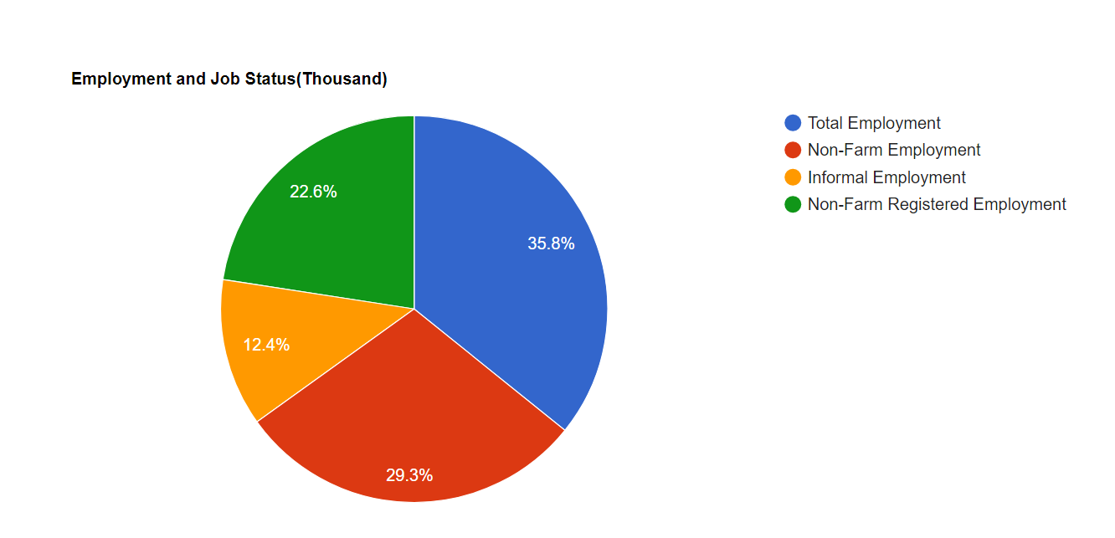

Slide 4
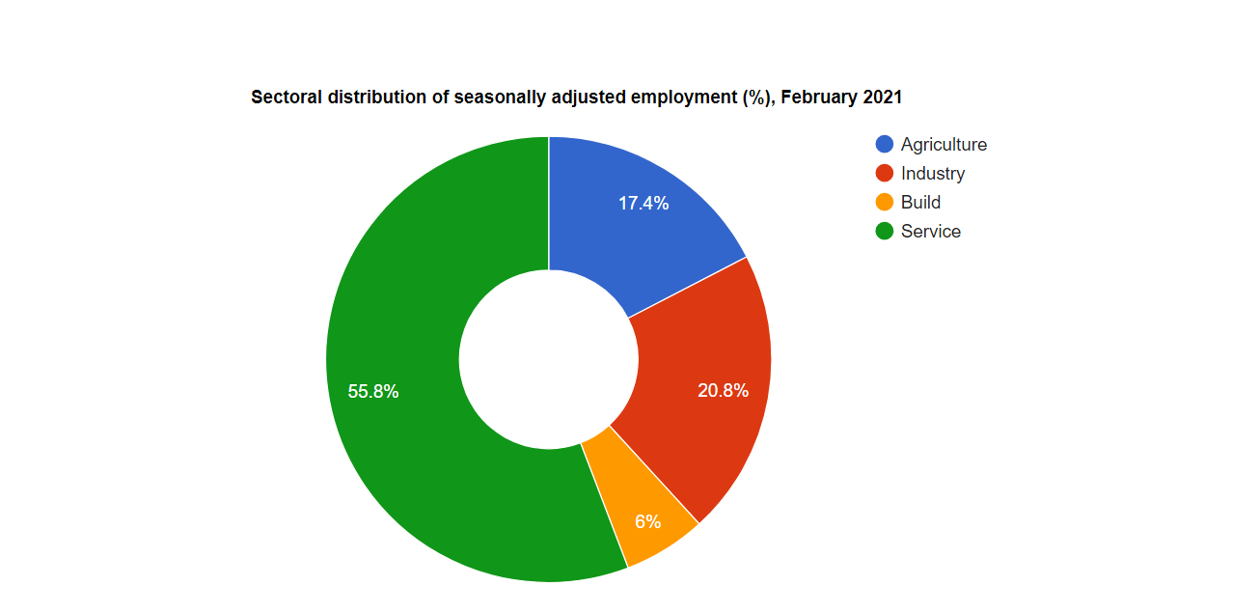

Slide 5
The pandemic process, which has dealt a heavy blow to public health and social life in the last year, has also deeply affected the Turkish economy. In the last 1 year with the pandemic, thousands of businesses have closed, poverty and unemployment have increased.

Slide 6
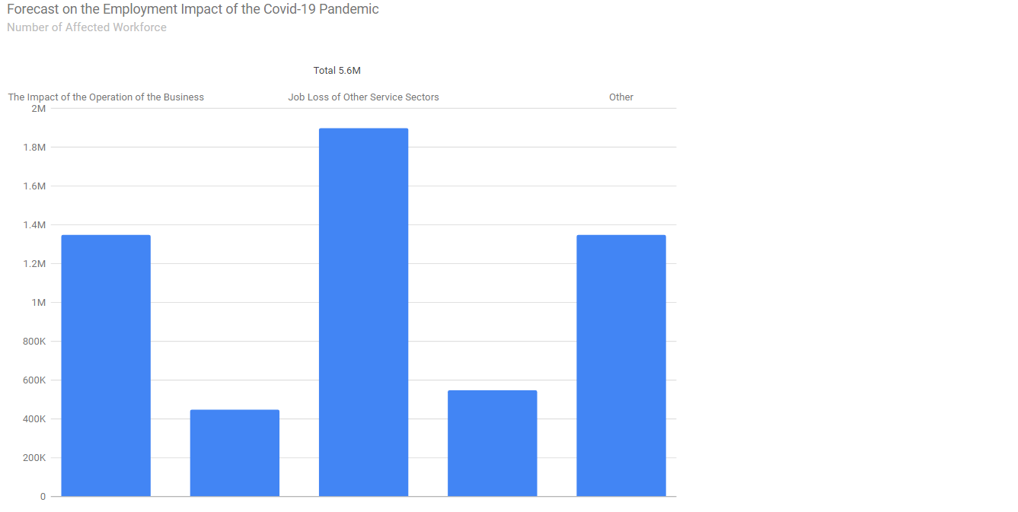

Slide 7
The inability to provide sufficient employment opportunities for the young workforce deepens youth unemployment. In addition to all these, the youth unemployment problem grows when the underemployed young labor force and the young labor force looking for a job although employed are added.

Slide 8
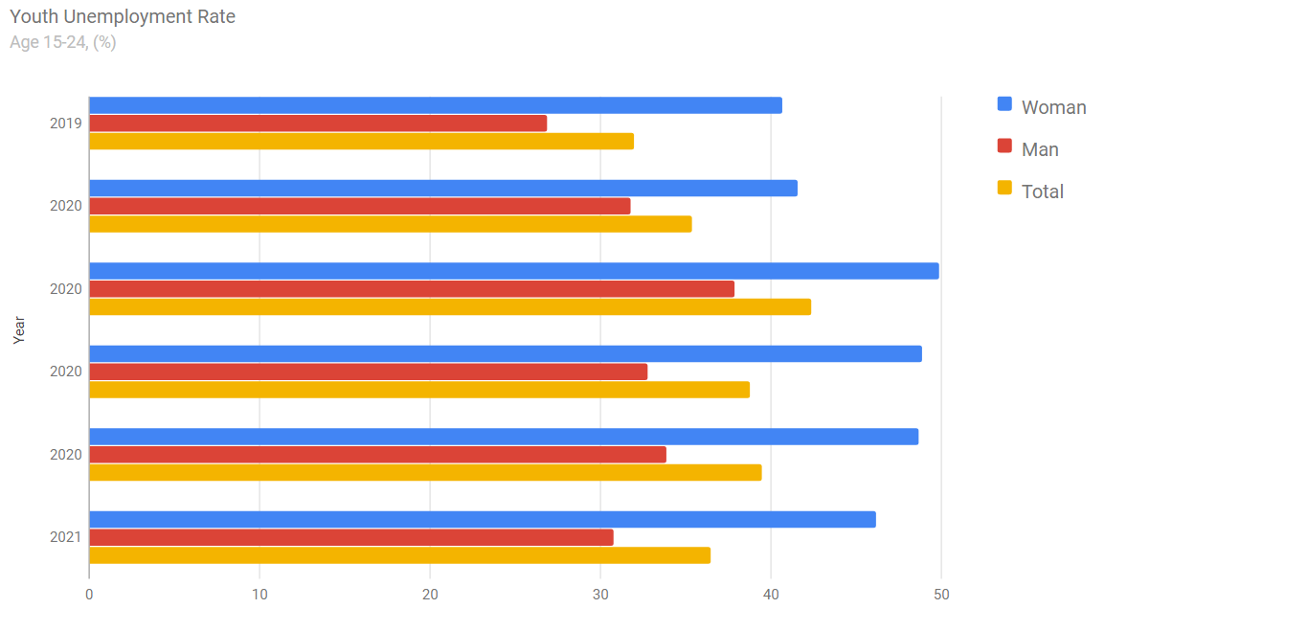

Slide 9
Another indicator that determines the characteristics of the labor market structure in Turkey is the job search period of unemployed individuals. In this context, it is seen that a significant part of the unemployed individuals search for a job less than 1 year. It is seen that the majority of unemployed individuals search for a job for 1-2 months.
On the other hand, it can be stated that individuals looking for a job for 3 years or more are at lower levels. The prolongation of job search for unemployed individuals reveals the concept of hopeless workforce. Disillusioned workforce or those with no hope of finding a job prefer to withdraw from the labor market because they have not been able to find a job for a long time.

Slide 10
